Slide 1
SENSOR BASED SOLUTION FOR FOOT RELATED PROBLEM

Slide 2
OUTLINE
INTRODUCTION
OBJECTIVES & APPLICATIONS
LITERATURE SURVEY
BLOCK DIAGRAM
FLOW CHART
DESCRIPTION OF PROJECT
FORCE SENSITIVE RESISTORS (FSRs)
RESULT ANALYSIS(FRONT-END,EXCEL SHEET,GRAPH)
CONCLUSION
FUTURE WORKS
REFERENCES

Slide 3
INTRODUCTION
Shoe Recommendations: By analyzing pressure distribution patterns, the system can accurately identify arch types (high, low) to recommend shoes with appropriate support.
Various foot related problems such as Flat foot and High Arch can be detected.
Foot measurements taken using Force Sensitive Resistors.
Foot pressure data can inform designers about the ideal shape, materials, and construction techniques for optimal comfort and performance.
Selecting shoes that match individual foot biomechanics, people can experience greater comfort and reduced foot pain throughout the day.
Medical solutions provided along side shoe recommendation for improving arch type.

Slide 4
OBJECTIVES & APPLICATIONS
The measurement of plantar pressure in various areas of the foot for detecting deformities present in the foot.
Detecting various foot type.
Use of the internet to upload data to the local host and firebase(for storage)
Shoe modifications and other solutions recommended for elderly people as well as people suffering from deformities.
Shoe Recommend System that provides better support and comfort.
Medical diagnosis and research
Sports and Military
Treatment to Old Age People and people with deformities.

Slide 5
LITERATURE SURVEY
Title | Year of publication | Advantages and Drawbacks
Development of Foot Pressure Monitoring System Using Force Sensor. | Year:2022 Published by: Politeknik & Kolej Komuniti Journal of Social Sciences and Humanities | Advantage: Contains various information about normal and flat foot Drawbacks: Due to use of foot contact and foot area which reduces the accuracy.
Comparison of flatfeet and normal feet using data of the gait cycle, contact area, and foot contact. | Date: 22 March 2021 Published by: PubMed, NIH | Advantage: This research tests and evaluates a foot pressure monitor prototype to analyze the pressure distribution on a person's foot. Drawbacks: The article only focuses on retrieving the various pressure data from different regions of the foot.
Addressing the Data Acquisition Paradigm in the Early Detection of Pediatric Foot Deformities | Date:7th September 2020 Published by: Sensors, MDPI | Advantage: The analysis of plantar pressure through podometry has allowed analyzing and detecting different types of disorders and treatments in child patients. Drawbacks: This article uses podometry techniques for pressure measurements which are very expensive.
A Simple Foot Plantar Pressure Measurement Platform System Using Force-Sensing Resistors | Date:4th August 2020 Published by: Applied System Innovation, MDPI | Advantage: This study aims to develop a low-cost measuring device using force-sensing resistor (FSR) sensors to evaluate bio-metric problems in the foot. Drawbacks: This article only focuses on the evaluation of the problem and not the solution.

Slide 6
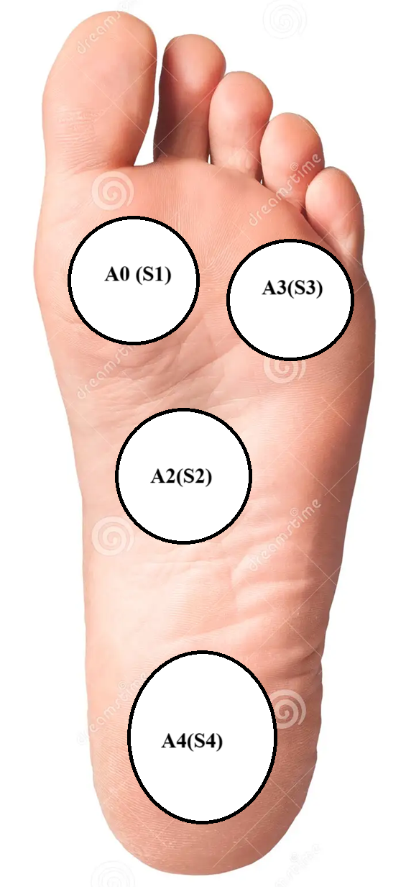
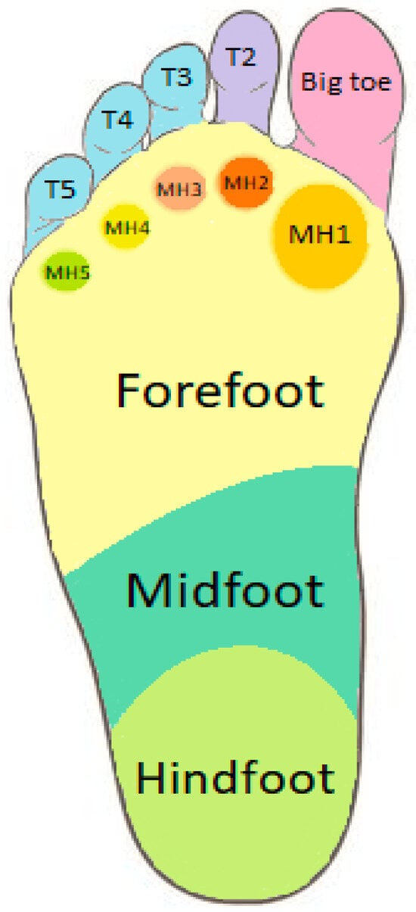
Contd…
From article “A Simple Foot Plantar Pressure Measurement Platform System Using Force-Sensing Resistors”, we were able to find the ranges of values to classify the different deformities that can occur in a person’s foot.
Deformities | Front (mV) | Middle(mV) | Rear(mV)
High Arch Index | 4300-4700 | 0-279 | 4700-4825
Normal | 4100-4300 | 280-1390 | 4400-4700
Flat Feet | 4100-4200 | 1400-4550 | 4700-4850
Table showing ranges of loads in various areas of the foot

Slide 7
BLOCK DIAGRAM OF THE PROJECT
Node.js
Uploading data to Firebase.
OUTPUT
(PROBLEM
DETECTION)
FSR
ARDUINO
UNO
BACK-END
(WEB)
FINAL OUTPUT
(SHOES AND EXERCISES RECOMMENDED)
Provides final output with proper shoe modification and medical solution recommendations
and links to proper websites.
FRONT -END
Displayed in Front-end
Problems that arises from deviated foot pressures from threshold

Slide 8
FLOW CHART OF PROJECT
Start
Placing foot on sensors
Measurements of pressure is taken from various footprints.
If value is less than the threshold in middle and normal or less in forefoot
Comparison with desired value
If the midfoot value exceed the forefoot values
All the values match
High Arch Index
Normal
Flat Feet
Foot type detected and displayed as well as sent to firebase for storage.
End

Slide 9
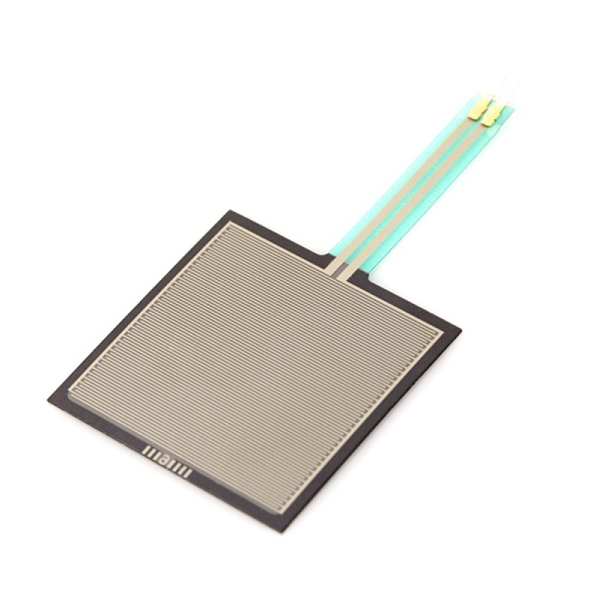
FORCE RESISTIVE SENSORS(FSRs)
Working:
Resistance Change: Resistance change when pressure is applied.
Signal Processing: The change in resistance is measured. This analog signal is then converted to a digital signal .
Data Interpretation: The digital signal is processed to generate a pressure map of the foot with values ranging from 0 to 1023.
Features:
High Sensitivity: Sensitive FSRs can measure minimum pressure of 0 -10 N.
Flexibility: They can be made into thin, flexible sheets to be used in soles of shoes.
Durability: Can withstand high temperature.
Low Cost: Compared to other pressure sensing technologies, FSRs are relatively inexpensive, making them suitable for widespread use .
Figure: FSR 406

Slide 10
WORKING OF THE FSR
As the resistance of the FSR decreases, the total resistance of the FSR and the constant resistor decreases. That means that the current flowing through both resistors increases which in turn causes the voltage across the fixed 10K resistor to increase.
Force (lb) | Force (N) | FSR Resistance | (FSR + R) ohm | Current thru FSR+R | Voltage across R
None | None | Infinite | Infinite | 0 mA | 0V
0.04 lb | 0.2 N | 30 Kohm | 40 Kohm | 0.13 mA | 1.3 V
0.22 lb | 1 N | 6 Kohm | 16 Kohm | 0.31 mA | 3.1 V
2.2 lb | 10 N | 1 Kohm | 11 Kohm | 0.45 mA | 4.5 V
22 lb | 100 N | 250 ohm | 10.25 Kohm | 0.49 mA | 4.9 V
The voltage change can be determined by the formula:
Vout = Vcc * R / (R + Rfsr)

Slide 11
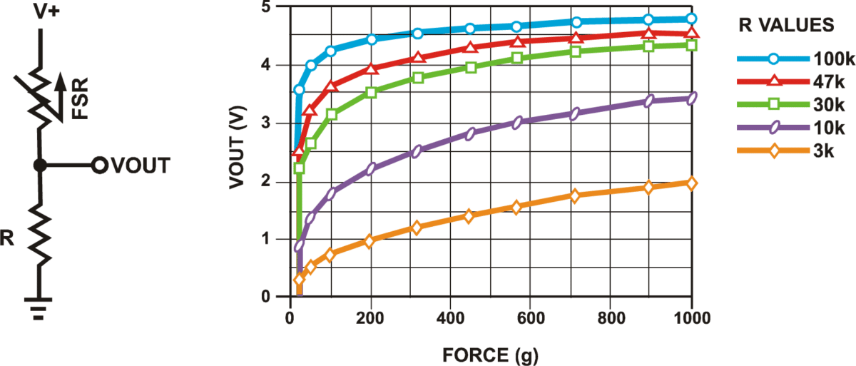
FSR SENSOR CIRCUIT AND GRAPH
FSR Circuit
The graph below displays the voltage vs force curve for the FSR 400 series sensor.
The response is not linear.
There is a spike in voltage when a small amount of pressure is applied. After that, the voltage is directly proportional to the applied force and saturates at one point.

Slide 12
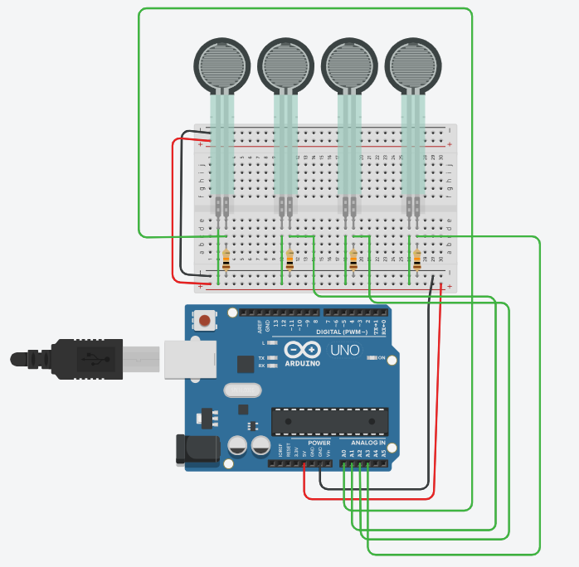
CIRCUIT ANALYSIS
Components:
4× FSR sensors (for S1–S4)
Arduino UNO
4× fixed resistors (usually 10kΩ)
Voltage divider circuits (1 per sensor)
Power: 5V (from Arduino)
ADC: Analog pins A0–A3
Circuit Summary:
Input: Foot pressure on FSR sensors
Conversion: Voltage drop changes with pressure
Readout: Arduino reads analog values (0–1023)
Output: Values sent via serial → classified by Node.js → shown in web UI and logged to Firebase.

Slide 13
DESCRIPTION OF PROJECT
Measuring foot pressures in various areas of the foot with the help of FSRs.
Transferring the values from the circuit to the serial monitor via Arduino.
Comparison with the desired values.
Evaluating whether the person has HAI, Flat feet or Normal feet.
Transferring data to the web-server using JavaScript and Firebase for storage.
Shoe modification recommendation and medical solutions in the Front-End.

Slide 14
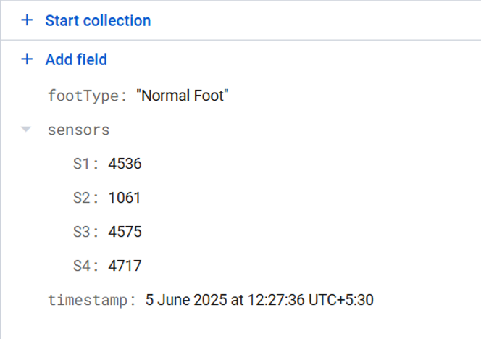
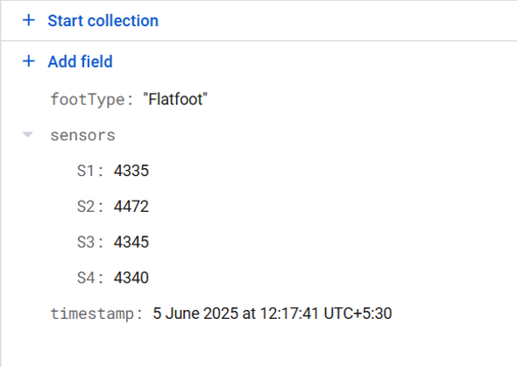
RESULT ANALYSIS
The following is the photograph of the database:
Normal Foot: In case of normal foot the values of S1 and S3(Fore Foot) as well as S4(Rear Foot) are much higher and S2(Mid Foot) is lower as compared to them.
Flat Foot: In case of Flat Foot the value of S2 is slight higher than the values of S1,S3,S4 and much higher than the normal threshold for mid foot range.

Slide 15
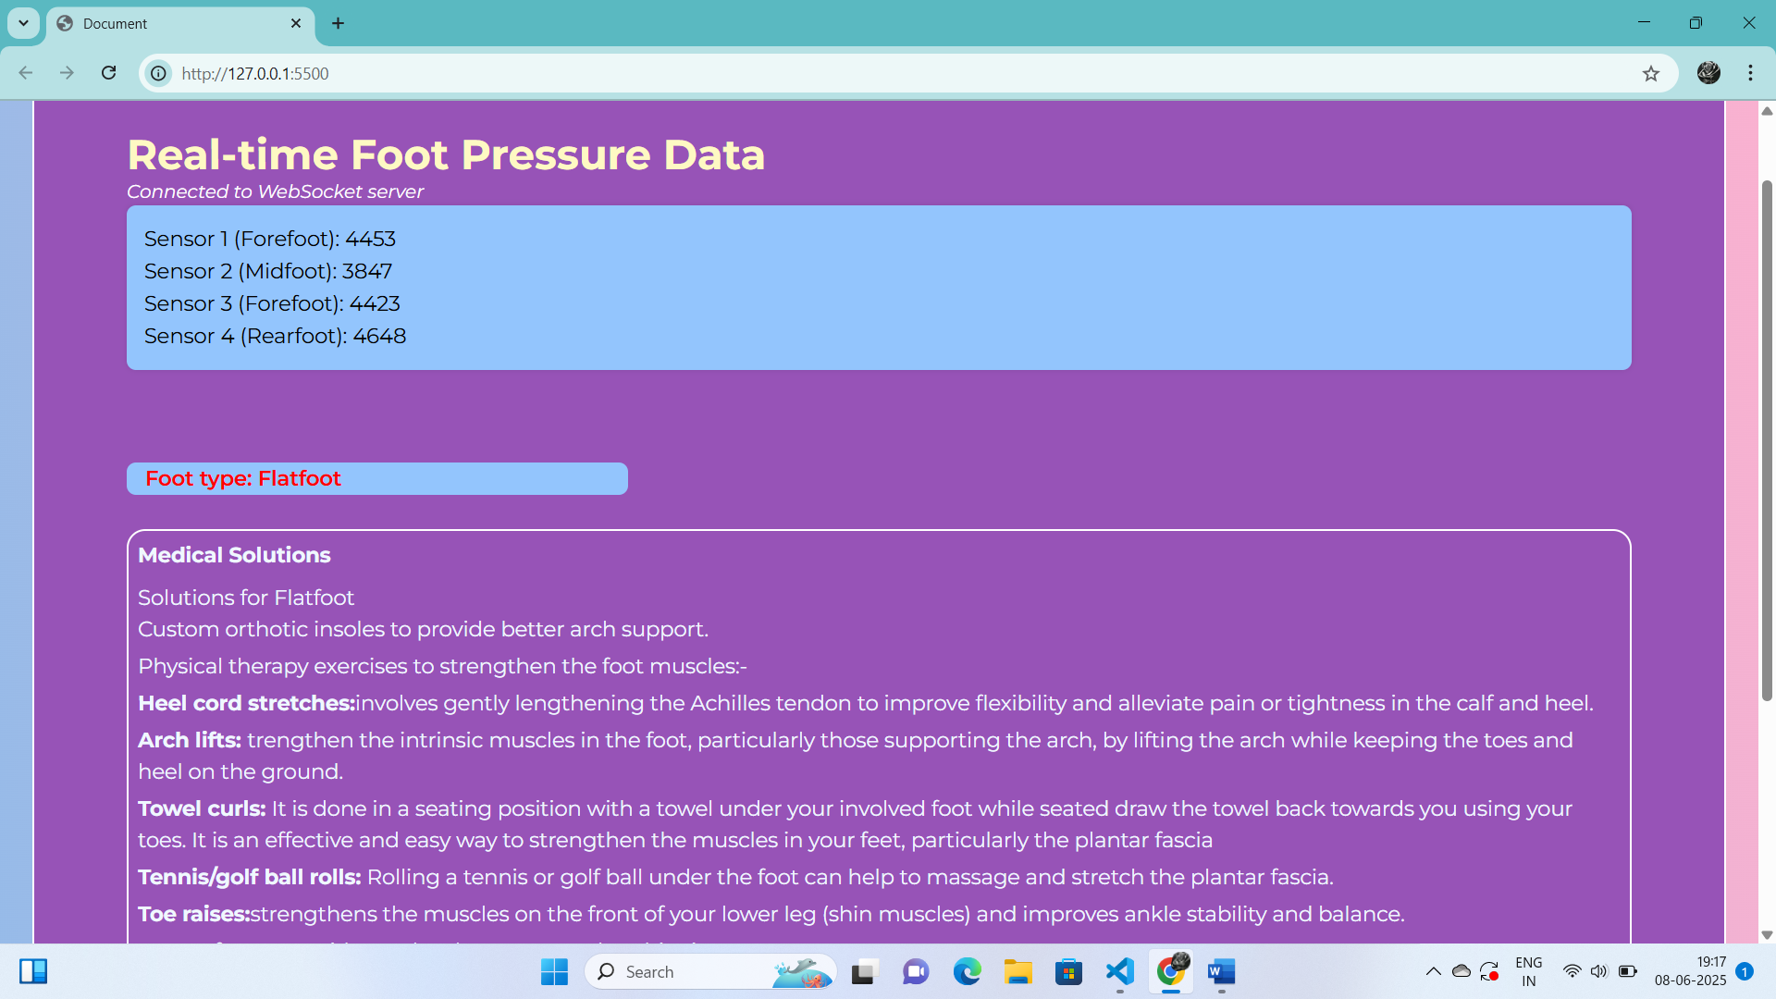
FRONT END ANALYSIS
The server running on local host gets updated on real time basis.

Slide 16
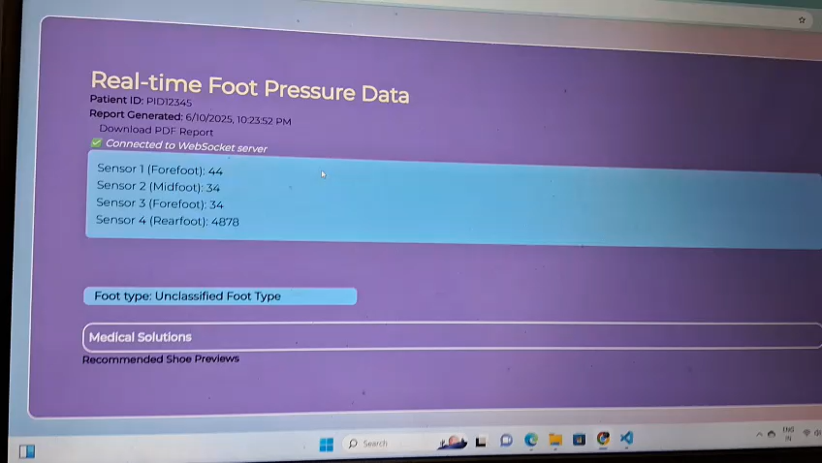
REAL TIME DETECTION AND ANALYSIS

Slide 17

RESULTS COLLECTED
The dataset comprises plantar pressure sensor readings from four sensors along with gender, age group, weight, height, and diagnosed foot type.
Points: High Arch (HAI), Flat foot(FF) and Normal Foot(NF).

Slide 18
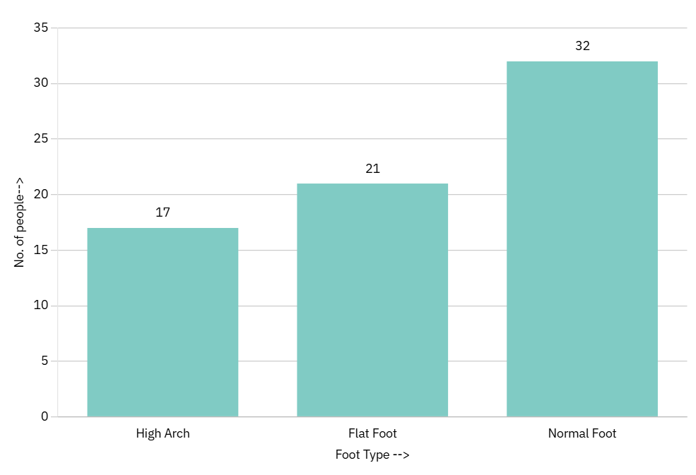
GRAPH ANALYSIS
Foot Types Detected
1.Normal Foot
2.Flat Foot
3. High Arch Index
Analysis
Normal Foot is the most common.
A notably large proportion (30%) of people show Flatfoot, which can lead to arch fatigue, ankle instability, or long-term musculoskeletal issues if left untreated.
High Arch is the least common but still significant (~25%).

Slide 19
CONCLUSION
This project presents a cost-effective and innovative solution to detect foot deformities such as High Arch Foot and Flat Feet, and to recommend appropriate footwear to alleviate discomfort and mitigate the progression of these conditions with the help of medical solutions.
By utilizing Force Sensitive Resistors (FSRs) to measure plantar pressure and integrating this data with an Arduino-UNO microcontroller, the system accurately captures and analyses the load distribution on the foot.
This approach offers a promising alternative to traditional, expensive medical tools used for similar purposes.
In summary, this project provides an efficient, low-cost, and accessible tool for detecting foot deformities and recommending corrective footwear of the patient.
Its simplicity, affordability, and focus on preventive care have the potential to revolutionize how foot health issues are addressed, especially in regions where expensive medical equipment is not feasible.
Future enhancements could include machine learning algorithms for more accurate diagnosis, expanded deformity categories, and integration with mobile applications to further improve user experience and accessibility.

Slide 20
FUTURE WORK
Enhancing the diagnosis by detecting several other deformities other than Flat Foot, High Arch.
Using Machine-Learning to get more accuracy in the detection.

Slide 21
REFERENCES
1.Hu, J.; Cao, H.; Zhang, Y.; Zheng, Y. Wearable Plantar Pressure Detecting System Based on FSR. In Proceedings of the 2018 2nd IEEE Advanced Information Management, Communicates, Electronic and Automation Control Conference, IMCEC 2018, Xi’an, China, 25–27 May 2018; pp. 1687–1691.
2. Van Hulle, R.; Schwartz, C.; Denoël, V.; Croisier, J.L.; Forthomme, B.; Brüls, O. A foot/ground contact model for biomechanical inverse dynamics analysis. J. Biomech. 2020, 100, 109412.
3. Zheng, Y.; Choi, Y.; Wong, K.; Chan, S.; Mak, A. Biomechanical assessment of plantar foot tissue in diabetic patients using an ultrasound indentation system. Ultrasound Med. Biol. 2000, 26, 451–456.
4. Wibowo, D.B.; Suprihanto, A.; Caesarendra, W.; Khoeron, S.; Glowacz, A.; Irfan, M. A Simple Foot Plantar Pressure Measurement Platform System Using Force-Sensing Resistors. Appl. Syst. Innov. 2020, 3(3), 33.

Slide 22
Thank You.

